Slide 1
Vitamin D and COVID-19: Update, December 30, 2020
William B. Grant, PhD
Sunlight, Nutrition and Health Research Center
San Francisco, CA, USA

Slide 2
Disclosure
I receive funding from Bio-Tech Pharmacal, Inc. (Fayetteville, AR), a supplier of research-grade vitamin D at low cost.
I also work closely with two vitamin D-advocacy organizations:
  GrassrootsHealth.net
  VitaminDWiki.com

Slide 3
Outline
Mechanisms of vitamin D in reducing COVID-19 risk
Observational studies of COVID-19 and 25(OH)D
“Quasi-experimental” studies of vitamin D supplementation of COVID-19 patients
RCTs of vitamin D treatment of COVID-19
SARS-CoV-2 seropositivity with respect to 25(OH)D
Racial disparities of seropositivity related to 25(OH)D
Seasonality of viral infections that peak in winter
Recommendations for vitamin D re COVID-19
Other benefits of vitamin D
For more information

Slide 4
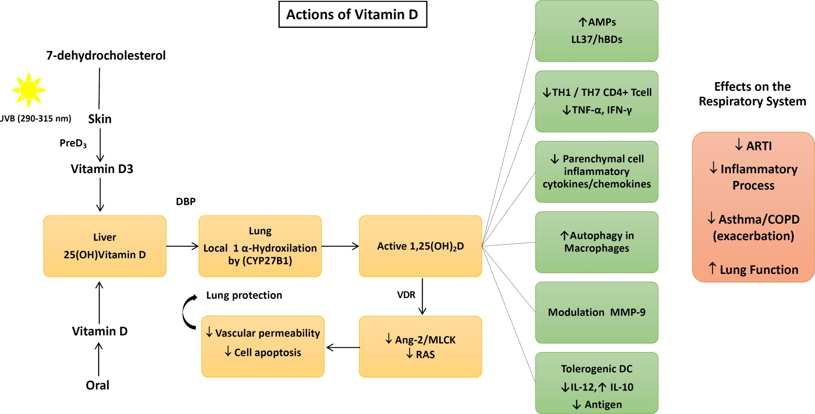
Mechanisms
Dos Santos et al. Arch Endocrinol Metab.
2020;S2359-39972020005006214.

Slide 5
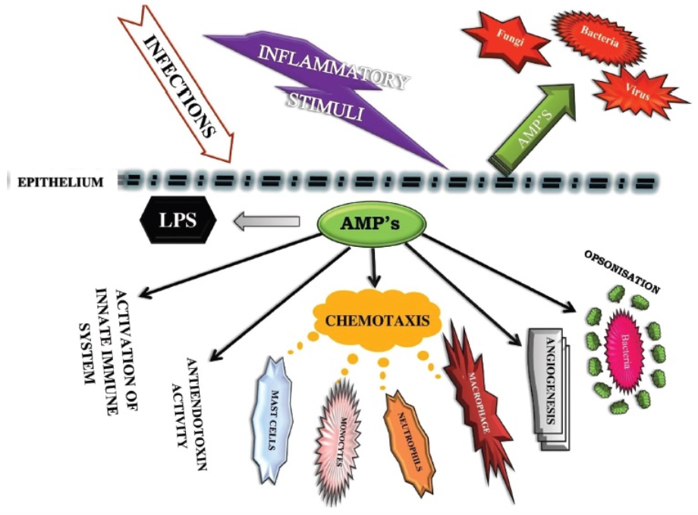
The cascade of events by the innate immune system in response to viral infections.
Evidence Regarding Vitamin D and Risk of COVID-19 and Its Severity.
Mercola J, Grant WB, Wagner CL.Nutrients. 2020 Oct 31;12(11):3361.

Slide 6
Human Cathelicidin (LL37)
Cathelicidin is a polypeptide with antimicrobial and antiendotoxin properties.
Cathelicidin is induced from macrophages by the action of 1,25(OH)₂D.
It reduces survival of viruses by puncturing the their surface, with or without an envelope.

Slide 7
Cytokine Storm
When the innate immune system produces too many pro-inflammatory cytokines, the resulting “cytokine storm” can damage the epithelial layer of the lungs, vascular system, and other organs as well as increase risk of pneumonia.
Vitamin D reduces risk of the “cytokine storm”.
Grant WB et al. Nutrients. 2020;12(6):1620.

Slide 8
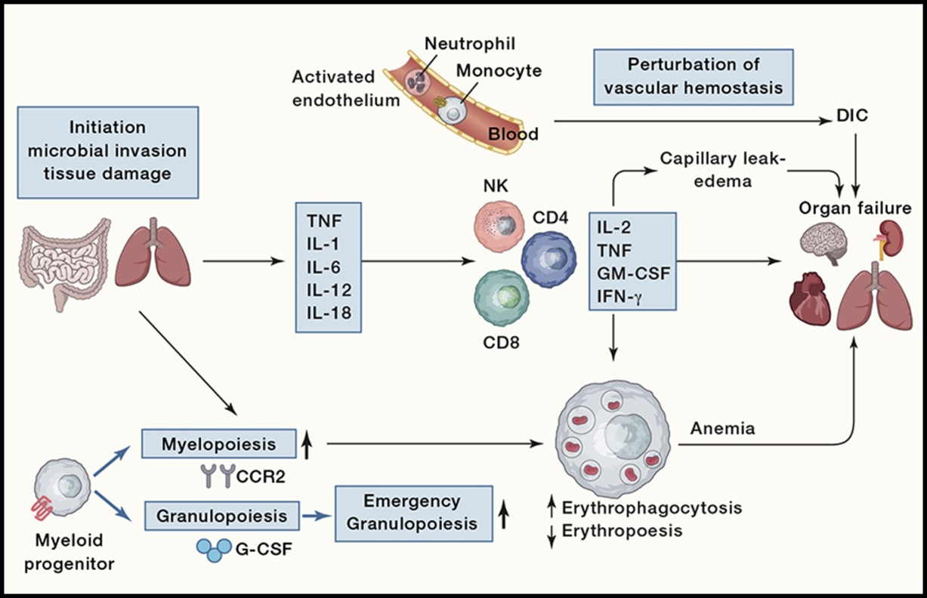
Cytokine Storms
Cytokine Storms: Understanding COVID-19.
Mangalmurti N, Hunter CA. Immunity. 2020 Jul 14;53(1):19-25.
doi: 10.1016/j.immuni.2020.06.017.

Slide 9
COVID-19: age, Interleukin-6, C-reactive protein, and lymphocytes as key clues
Age and age-related comorbidities, such as dyslipidaemia, hypertension or diabetes, determined more frequent severe forms of the disease in this study. Our (584 Spanish) cases are older than those so far reported and the clinical course of the disease is found to be impaired by age. Immunosenescence might be therefore a suitable explanation for the hampering of immune system effectors. The adaptive immunity would become exhausted and a strong but ineffective and almost deleterious innate response would account for COVID-19 severity. Angiotensin-converting enzyme inhibitors used by hypertensive patients have a protective effect in regards to COVID-19 severity in our series.
Jurado et al. Immun Ageing. 2020 Aug 14;17:22. doi: 10.1186/s12979-020-00194-w.

Slide 10
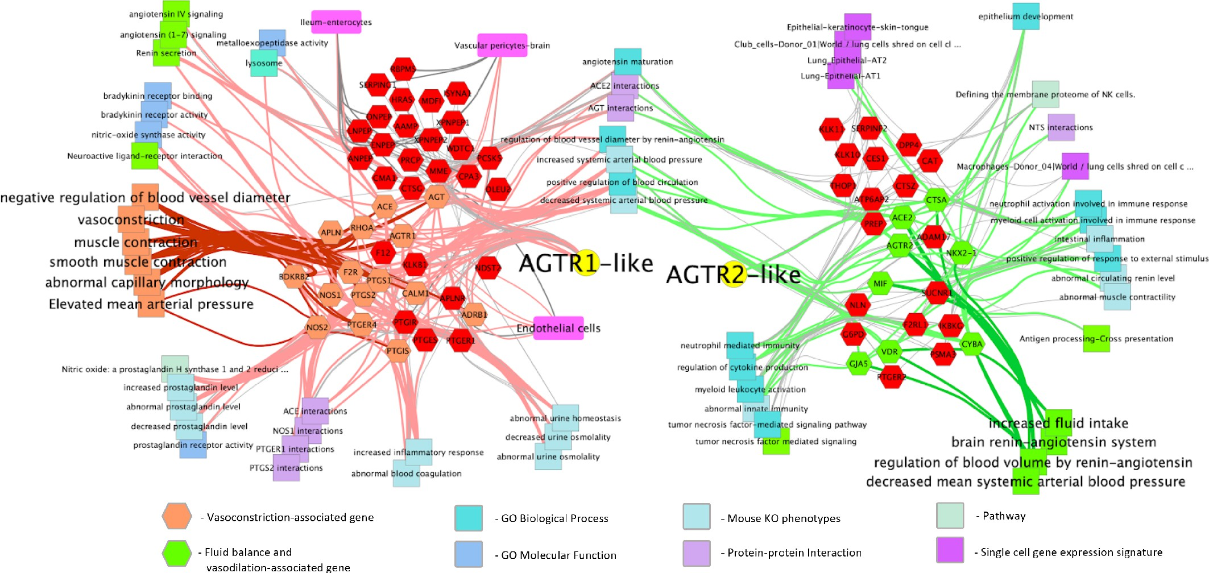
network of genes involved in the hypertension-hypotension axis

Slide 11
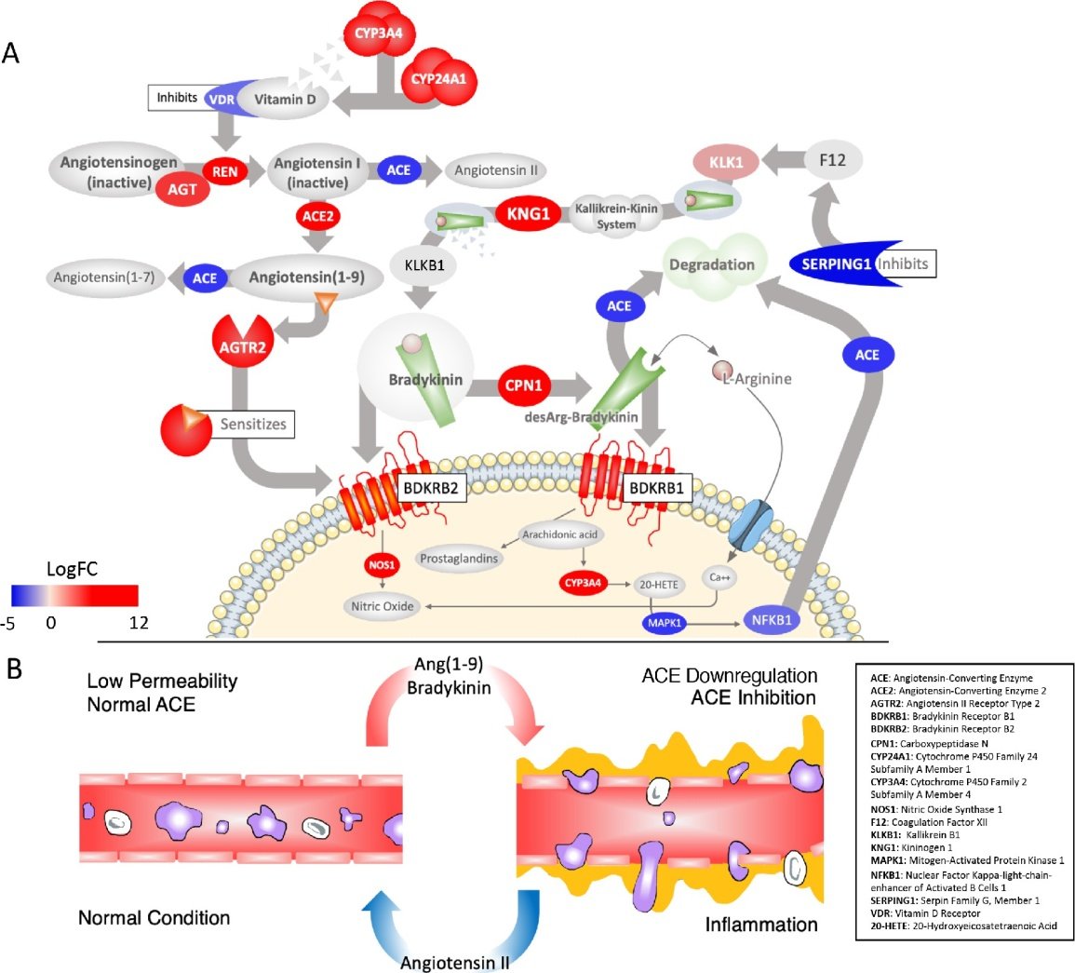
RAS-Mediated bradykinin storm
Garvin, M.R. ….Jacobson, D.
A mechanistic model and
therapeutic interventions for
COVID-19 involving a RAS-
Mediated bradykinin storm.
eLife 2020, 9, 9.

Slide 12
Observational Studies of COVID-19 with Respect to serum 25(OH)D
To date there have been at least 15 reports of COVID-19 with respect to serum 25(OH)D concentration.
Most have reported inverse correlations of COVID-19 risk, severity and/or death with respect to serum 25(OH)D concentration.
In general:
  Death: 25(OH)D <10 ng/mL (25 nmol/L)
  Severe disease: 25(OH)D <20 ng/mL
  Moderate disease: 20 ng/ml <25(OH)D <30 ng/mL
  Mild disease: 25(OH)D >30 ng/mL

Slide 13
Observational Studies of SARS-CoV- 2 and COVID-19 and 25(OH)D
Many observational studies have found inverse correlations between 25(OH)D concentrations at time of diagnosis.
However, serum 25(OH)D concentration drops when an acute illness associated with inflammation develops.
The mechanism seems to be that vitamin D-binding protein concentrations decrease.
Thus, observational studies are somewhat suspect.

Slide 14
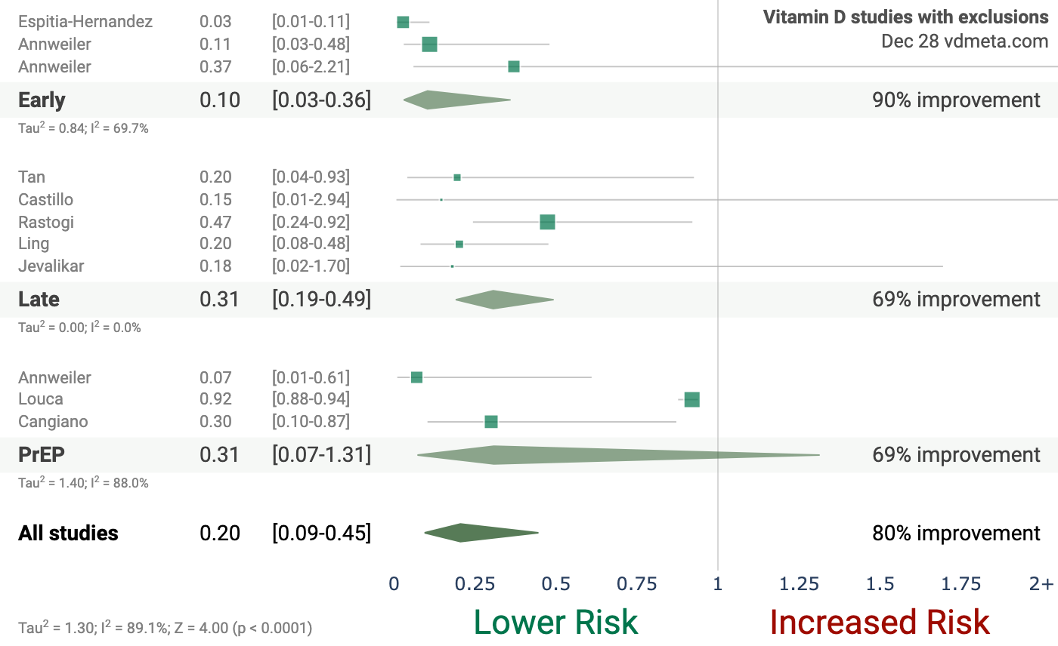
https://c19vitamind.com/

Slide 15
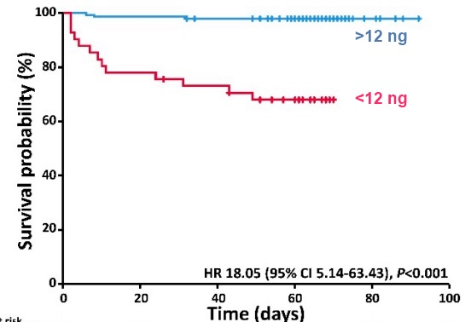
Much More Likely to Die of COVID-19 if 25(OH)D <12 ng/ml (30 nmol/L)
Based on 185 Patients aged 50-70 years in Germany
HR 15 (95% CI 4–52,
p < 0.001)
Nutrients 2020, 12(9), 2757;
https://doi.org/
10.3390/nu12092757

Slide 16
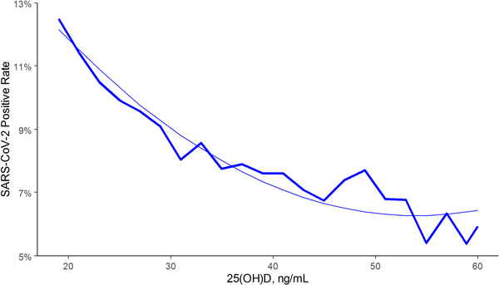
SARS-CoV-2 positivity rates and circulating 25(OH)D levels in the total population, U.S., from Quest Diagnostics
COVID-19 can develop if the
immune system response is dysregulated
Kaufman,… Holick, PLoS One. 2020 Sep 17;15(9):e0239252.

Slide 17
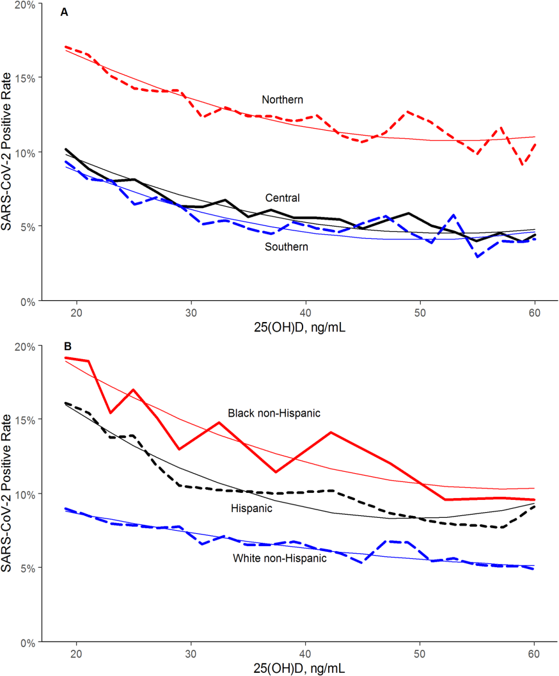
Effects of Race and 25(OH)D on SARS-CoV-2 seropositivity
The findings regarding race/ethnicity
and seropositivity indicate that blacks
and Hispanics have higher rates than
whites primarily due to non-vitamin D
effects. However, if blacks and Hispanics
were to increase 25(OH)D concentrations
by vitamin D supplementation, they
could reduce seropositivity by about 30%

Slide 18
Quasi-Experimental Study
Population: 66 residents of a nursing home in France with recently diagnosed COVID-19; mean age 88±9 yrs.
Intervention: 57 had received 80,000 IU vitamin D the previous month or within one week after diagnosis of COVID-19.
Outcome: During follow up of 36±17 days, 83% of supplemented residents survived; only 44% of comparator group (N = 9) survived; aHR = 0.11 (95% CI, 0.03 to 0.48, p=0.003).
Annweiler et al. JSBMB
https://doi.org/10.1016/j.jsbmb.2020.105771

Slide 19
Vitamin D Supplementation Associated to Better Survival in Hospitalized Frail Elderly COVID-19 Patients: The GERIA-COVID Quasi-Experimental Study
An observational study in France.
77 patients consecutively hospitalized for COVID-19 in a geriatric unit were included. Intervention groups were participants regularly supplemented with vitamin D over the preceding year [50,000 IU/month vitamin D3 or 80k-100k every 2-3 months (Group 1)], and those supplemented with 50,000 IU vitamin D₃ after COVID-19 diagnosis (Group 2). There was also a comparator group not supplemented with vitamin D.

Slide 20
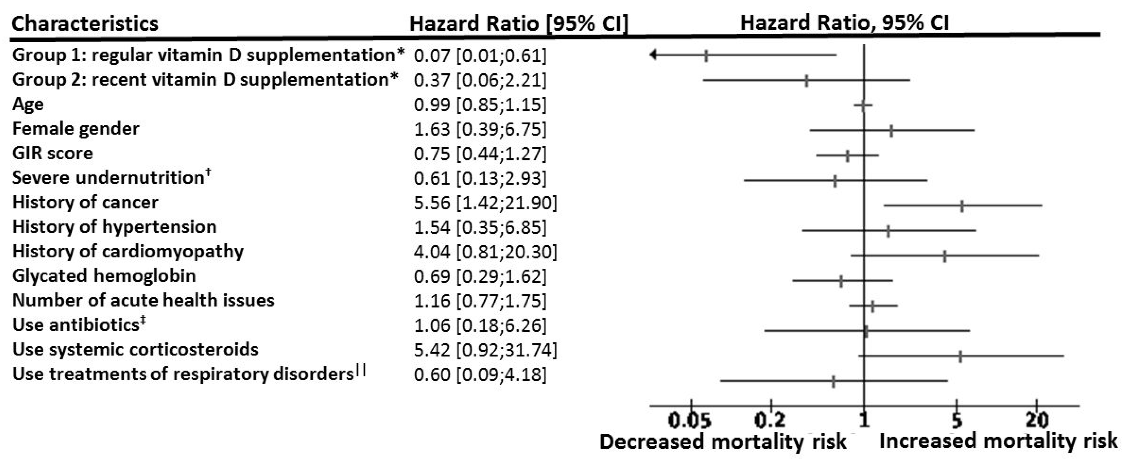
Vitamin D Supplementation Associated to Better Survival in Hospitalized Frail Elderly COVID-19 Patients:
14-day outcomes
Compared to the non-supplemented group, adjusted for age, gender and GIR score (a measure of functional ability)

Slide 21
"Effect of Calcifediol Treatment and best Available Therapy versus best Available Therapy on ICU Admission and Mortality Among Patients Hospitalized for COVID-19: A Pilot Randomized Clinical study“ Cordoba, Spain
All hospitalized patients (76) received as best available therapy the same standard care of a combination of hydroxychloroquine and azithromycin. Eligible patients (50) were allocated to take oral calcifediol (0.532 mg), or not. Patients in the calcifediol treatment group continued with oral calcifediol (0.266 mg) on day 3 and 7, and then weekly until discharge or ICU admission.
(Calcifediol is 25(OH)D₃ and week one treatment: 130,000 IU vitamin D₃. Calcifediol acts faster that vitamin D by a day or two due to bypassing conversion in the liver.)
Entrenas Castillo et al. J Steroid Biochem Mol Biol. 2020 Oct;203:105751 doi: 10.1016/j.jsbmb.2020.105751. Epub 2020 Aug 29.

Slide 22
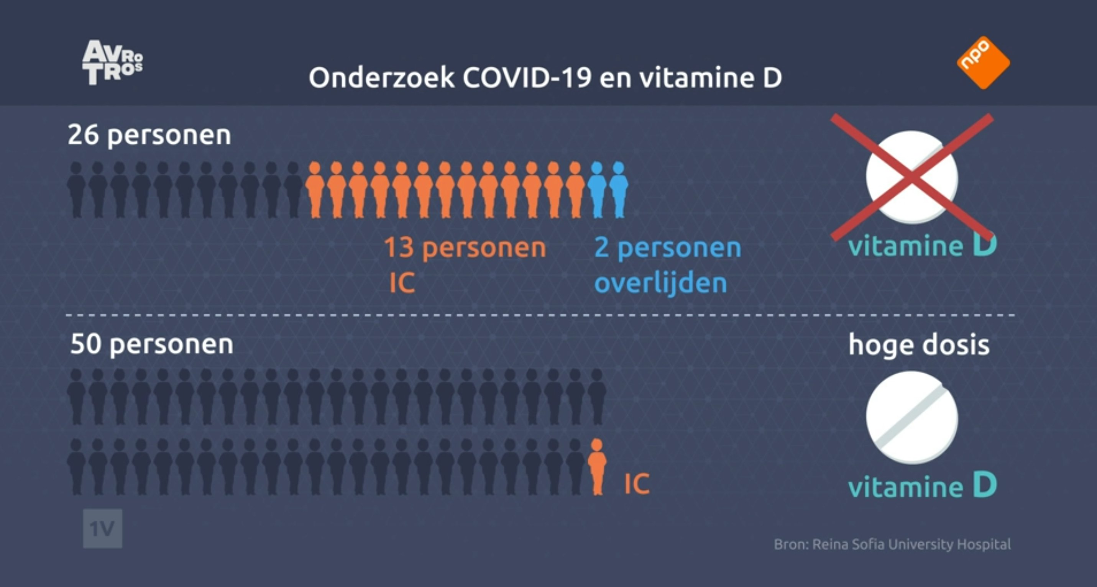
Results of the Pilot Randomized Clinical study – Entrenas Castillo et al., 2020

Slide 23
Short term, high-dose vitamin D supplementation for COVID-19 disease: a randomised, placebo-controlled, study (SHADE study)
An RCT conducted in India involving 40 asymptomatic or mildly symptomatic SARS-CoV-2 RNA positive vitamin D deficient (25(OH)D<20 ng/ml) individuals admitted to a tertiary hospital in north India without major comorbidities or requiring invasive ventilation or having 25(OH)D >20 ng/ml.
16 intervention participants, 6 males, age 50 (36-51) years, 25(OH)D = 9 (7 – 13) ng/ml
24 controls, 14 males, age 48 (39 – 49) years, 25(OH)D = 10 (8 – 13) ng/ml
Rastogi A, et al, Malhotra P.Postgrad Med J. 2020 Nov 12:postgradmedj-2020-139065. doi: 10.1136/postgradmedj-2020-139065.

Slide 24
Short term, high-dose vitamin D supplementation for COVID-19 disease: Results
10 out of 16 patients achieved 25(OH)D>50 ng/ml by day-7 and another two by day-14 [day-14 25(OH)D levels 52 (49 to 60) ng/ml in intervention group and 15 (13 to 20) ng/ml (p<0.001) in the control group].
10 (63%) participants in the intervention group and 5 (21%) participants in the control arm (p<0.02) became SARS-CoV-2 RNA negative.
Fibrinogen levels significantly decreased with vitamin D₃ supplementation (intergroup difference 0.70 ng/ml; P=0.007) unlike other inflammatory biomarkers.

Slide 25
Vitamin D Trial in a Brazilian Hospital Failed
Findings: In this double-blind, randomized, placebo-controlled trial involving 240 hospitalized patients with severe COVID-19, a single dose of 200,000 IU of vitamin D3 supplementation was safe and effective in increasing 25-hydroxyvitamin D concentrations, but did not significantly reduce hospital length of stay or any other 10 clinically-relevant outcomes compared with placebo.
Problem: Supplementation began after 10 days of symptoms, when 70-80% were on oxygen therapy.
Murai et al. medRxiv, Nov. 17, 2020

Slide 26
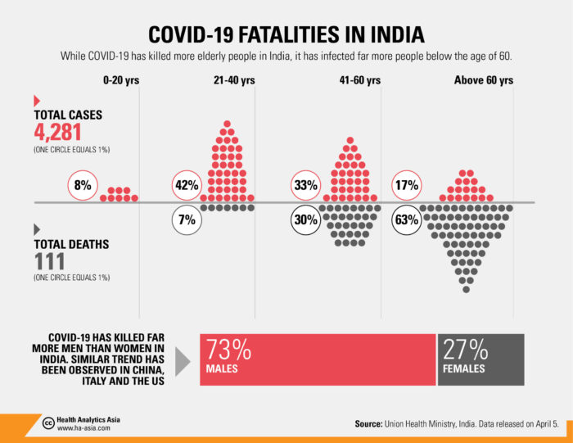
Effect of Age on Incidence, Death
73%
Males
27%
Females

Slide 27
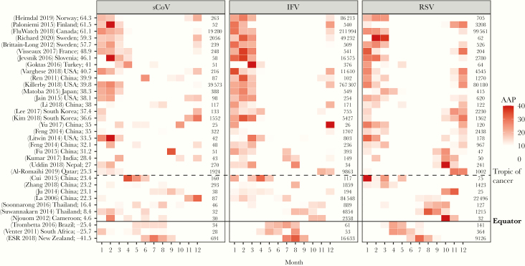
Seasonality of Viral Infections
You Li et al. J Infect Dis. 2020 Sep 1;222(7):1090-1097. doi: 10.1093/infdis/jiaa436

Slide 28
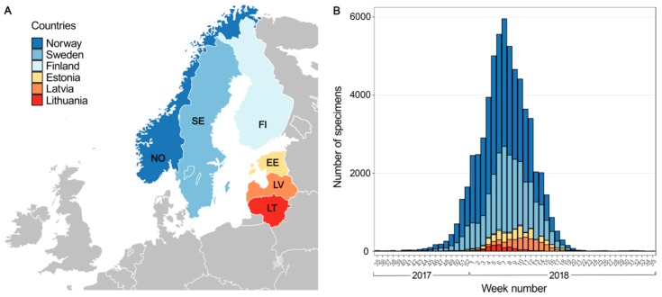
Low Temperature and Low UV Indexes Correlated with Peaks of Influenza Virus Activity in Northern Europe during 2010⁻2018
Ianevski et al. Viruses. 2019 Mar 1;11(3):207. doi: 10.3390/v11030207.

Slide 29
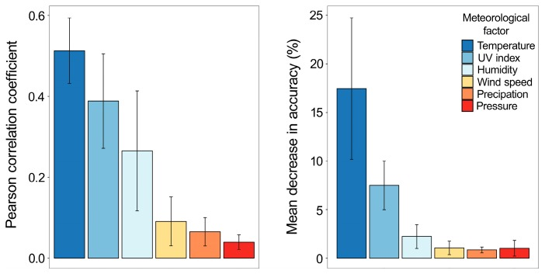
Low Temperature and Low UV Indexes Correlated with Peaks of Influenza Virus Activity in Northern Europe during 2010⁻2018
Implications:
Influenza rates are
reduced in winter at high latitudes due to lower temperature, UV dose, and humidity giving rise to increased viability of the virus outside the human body.

Slide 30
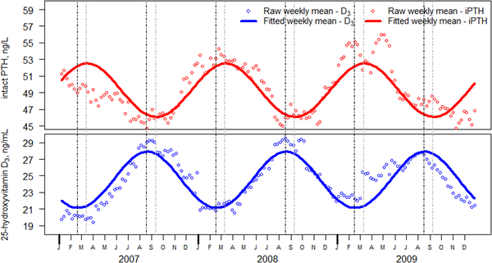
Seasonal Variation in Serum 25(OH)D and PTH in the U.S.
Kroll et al. PLoS One. 2015. doi: 10.1371/journal.pone.0118108

Slide 31
Other Benefits of UVB Exposure and Vitamin D Supplementation
Cancer prevention
Reduced risk of pregnancy and birth outcomes
Prevention of dental caries
Increased life expectancy

Slide 32
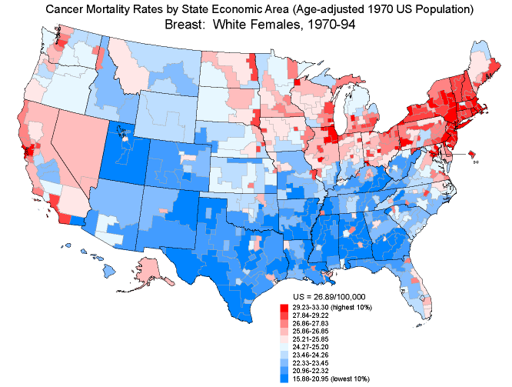

Slide 33
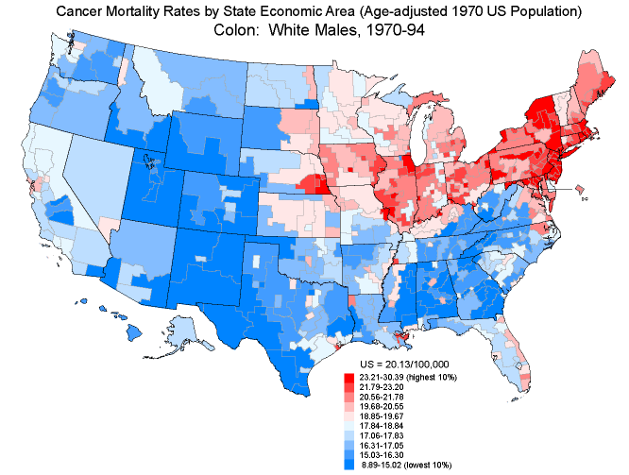

Slide 34
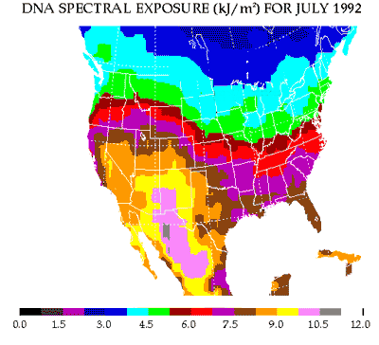

Slide 35
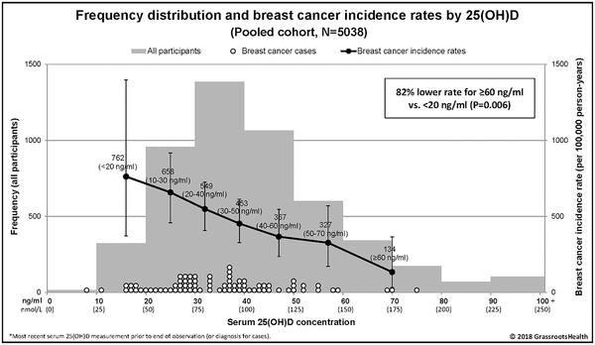
Breast cancer risk markedly lower with serum 25-hydroxyvitamin D concentrations ≥60 vs <20 ng/ml
McDonnell et al., (GrassrootsHealth.net) PLoS One, 2018

Slide 36
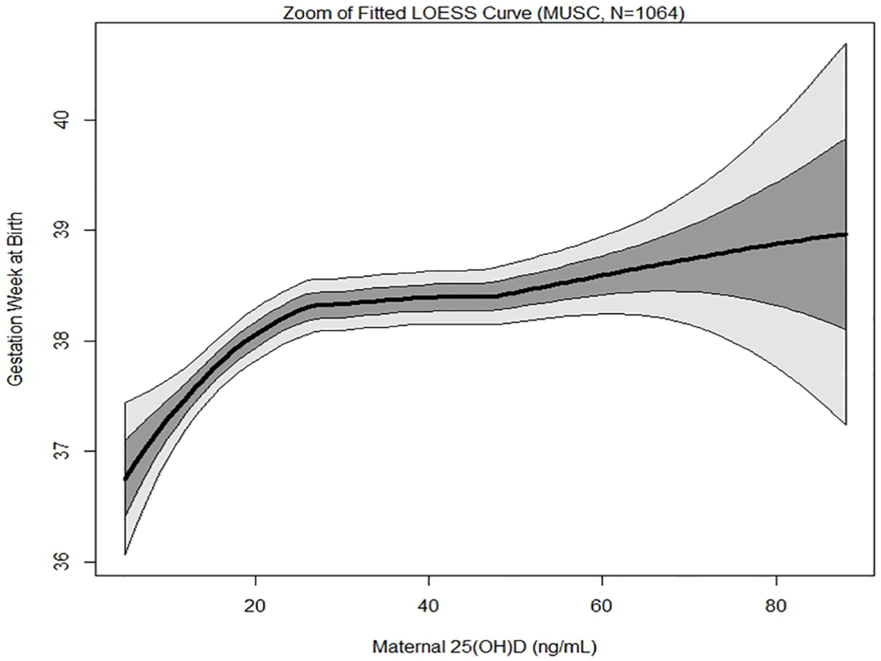
Maternal 25(OH)D concentrations ≥40 ng/mL vs. <20 ng/ml associated with 60% lower preterm birth risk
McDonnell et al. (GrassrootsHealth.net), PloS One, 2017

Slide 37
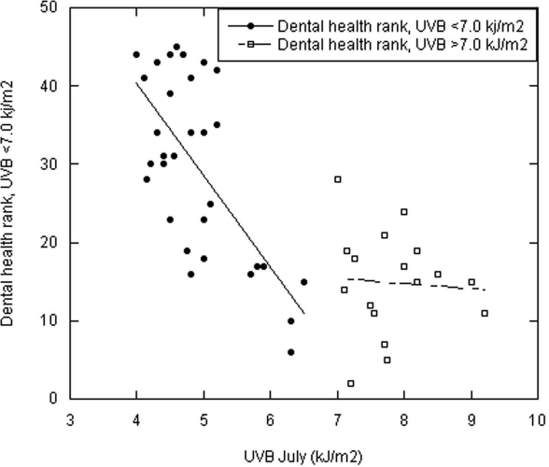
Dental Rank vs. Solar UVB Dose in July for Servicemen, 1920s & 1930s
High dental rank
indicates poor dental health
Grant.
Dermato-Endocrinology. 2011

Slide 38
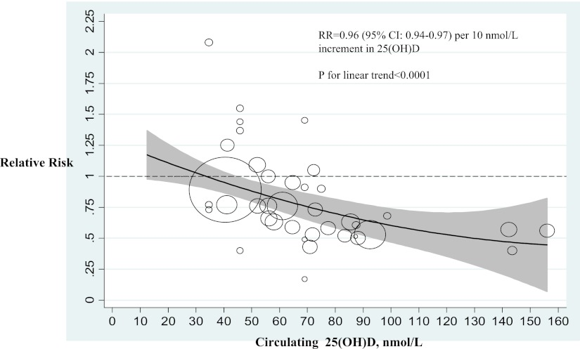
Type 2 Diabetes Mellitus vs 25OHD
Song et al.,
2013

Slide 39
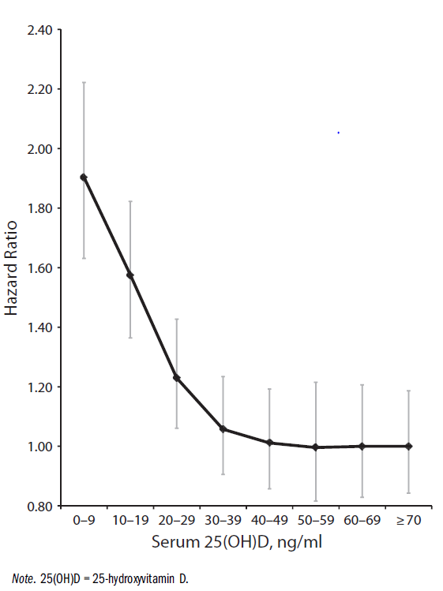
All-cause Mortality Rate vs. 25(OH)D
Garland CF, Kim JJ, Mohr SB,
Gorham ED, Grant WB,
Giovannucci EL, Baggerly L,
Hofflich H, Ramsdell J, Zeng K,
Heaney RP.
Meta-analysis of all-cause mortality
according to serum
25-hydroxyvitamin D.
Am J Pub Health.
2014 Aug;104(8):e43-50.

Slide 40
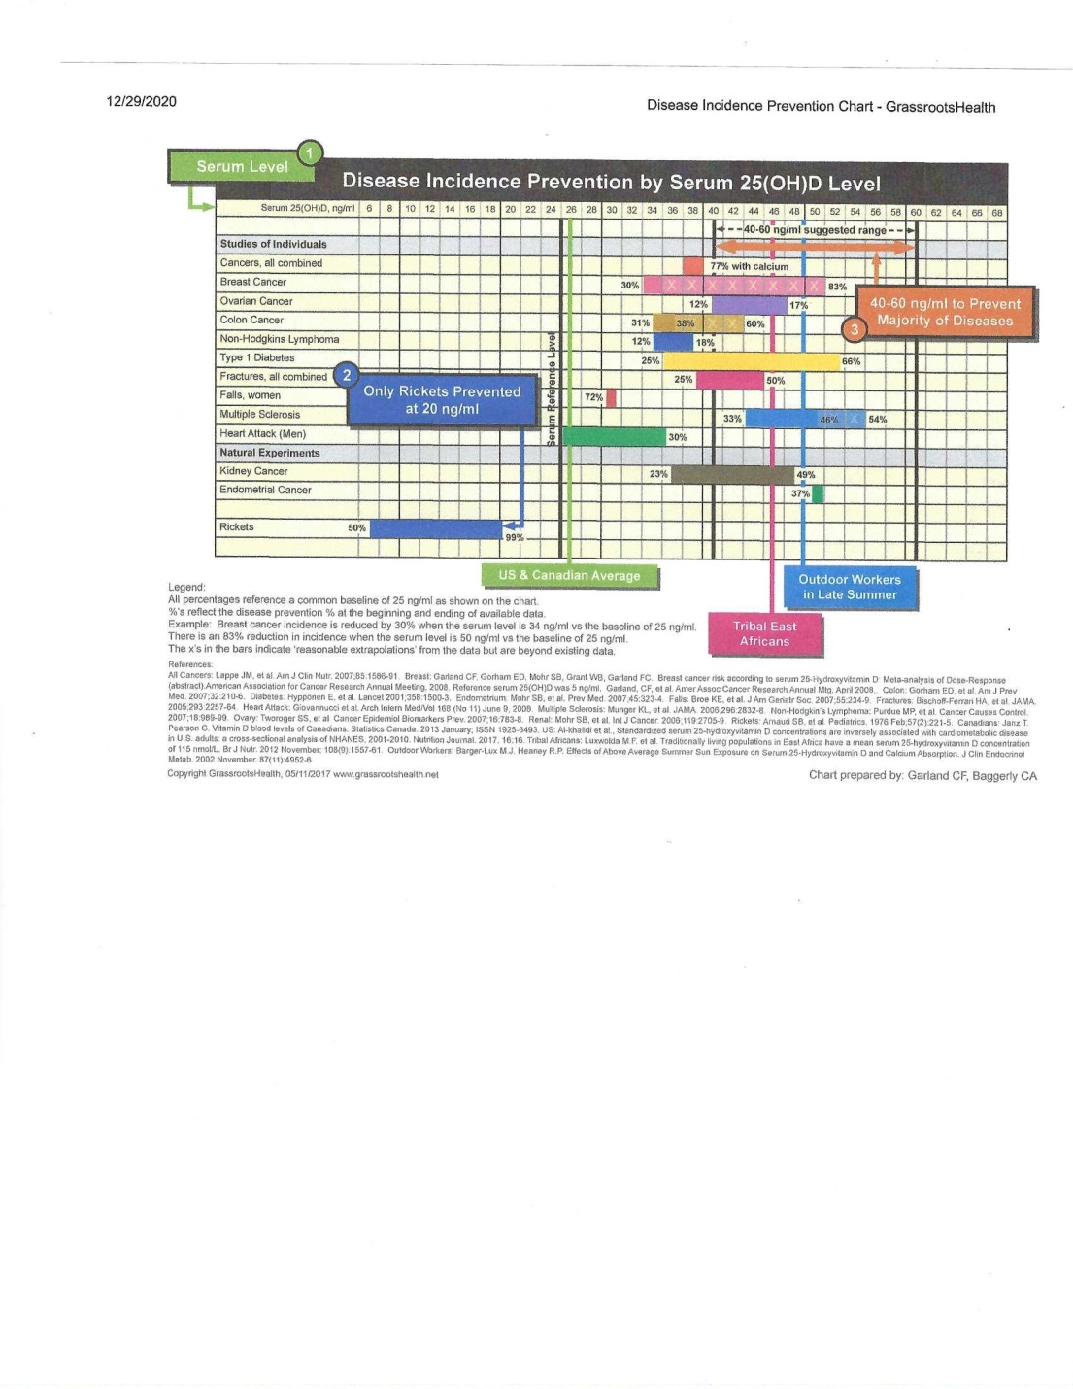
Disease Incidence Prevention by 25(OH)D – Grassrootshealth.net

Slide 41
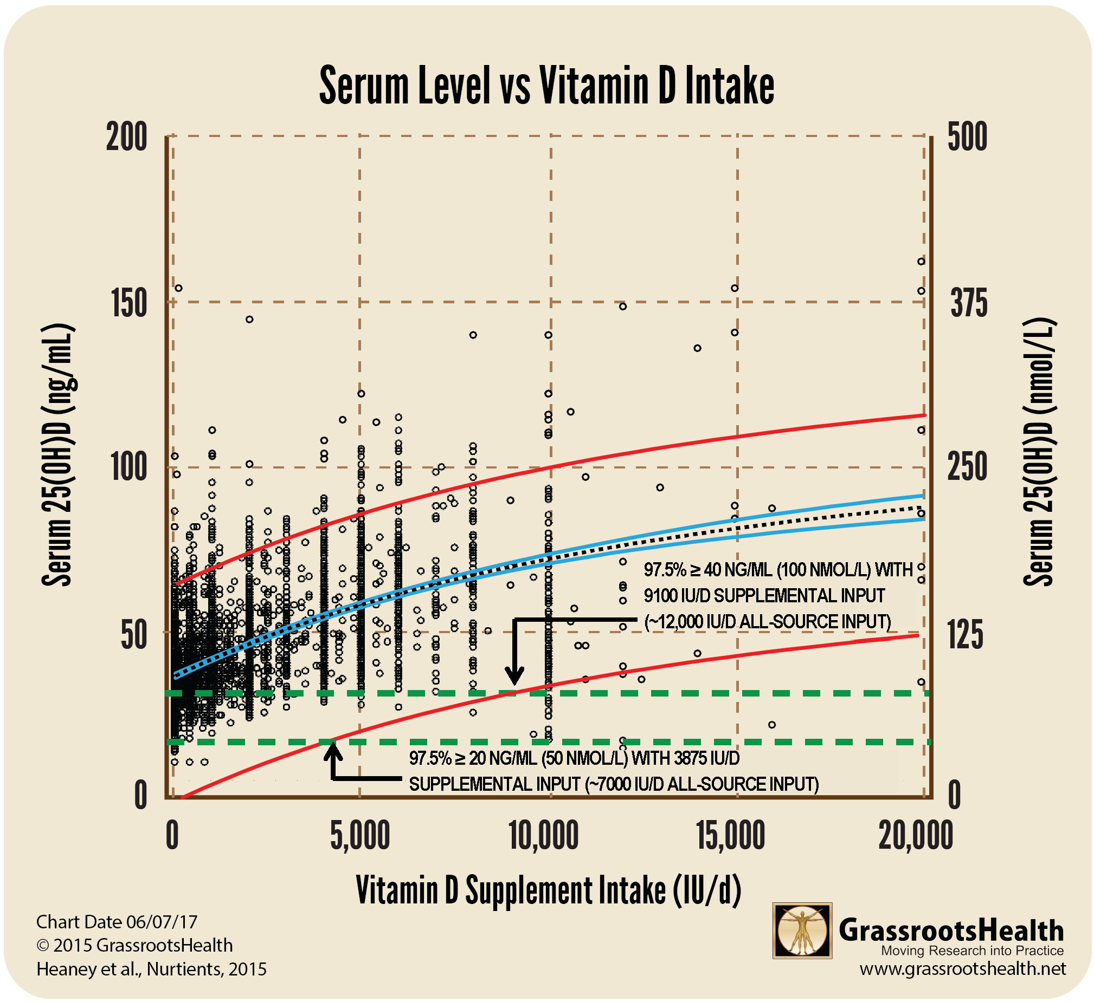
25(OH)D vs. Vitamin D Supplemtation, GrassrootsHealth.net

Slide 42
Recommendations
For health care workers dealing with COVID-19 patients;
For those at greatest risk of COVID-19 (elderly, obese, chronic diseases, lung diseases, high social contact from occupation, institution, living arrangement);
For those with recently diagnosed COVID-19 or SARS-CoV-2 seropositivity:
Consider taking a bolus dose of vitamin D (D₃ referred, D₂ not as good) to rapidly raise 25(OH)D concentration, followed by reasonable daily doses. Consider supplementing with magnesium as well.

Slide 43
Details Regarding 14 Observational Studies, 3 Treatment Studies, and Mechanisms are Discussed in This Open Access Review
Mercola J, Grant WB, Wagner CL.
Evidence Regarding Vitamin D and Risk of COVID-19 and Its Severity.
Nutrients. 2020 Oct 31;12(11):E3361.
doi: 10.3390/nu12113361.

Slide 44
For Further Information
Search for journal publications
  https://pubmed.ncbi.nlm.nih.gov/
  https://scholar.google.com/
Vitamin D advocacy organizations
  Grassrootshealth.net
  VitaminDWiki.com (has a large collection of vitamin D information)

